Slide 1
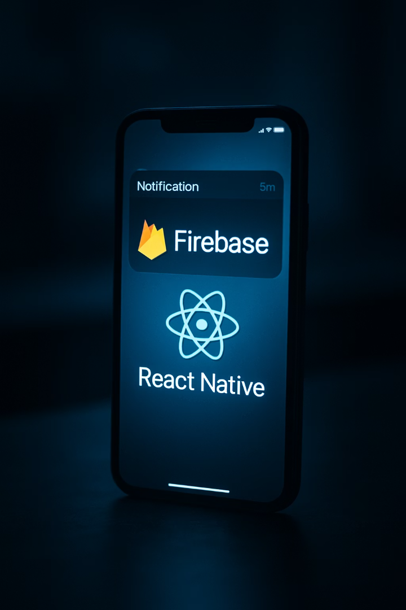
React Native Push Notifications with Firebase
A comprehensive guide to implementing push notifications for your Expo-based React Native applications using Firebase Cloud Messaging.

Slide 2





Why Push Notifications Matter
User Engagement
Notifications can increase app engagement by up to 88%.
Real-time Updates
Keep users informed with timely information.
Retention Driver
Apps with push notifications have 3x better retention rates.
User Journey Control
Guide users to specific screens or actions within your app.

Slide 3
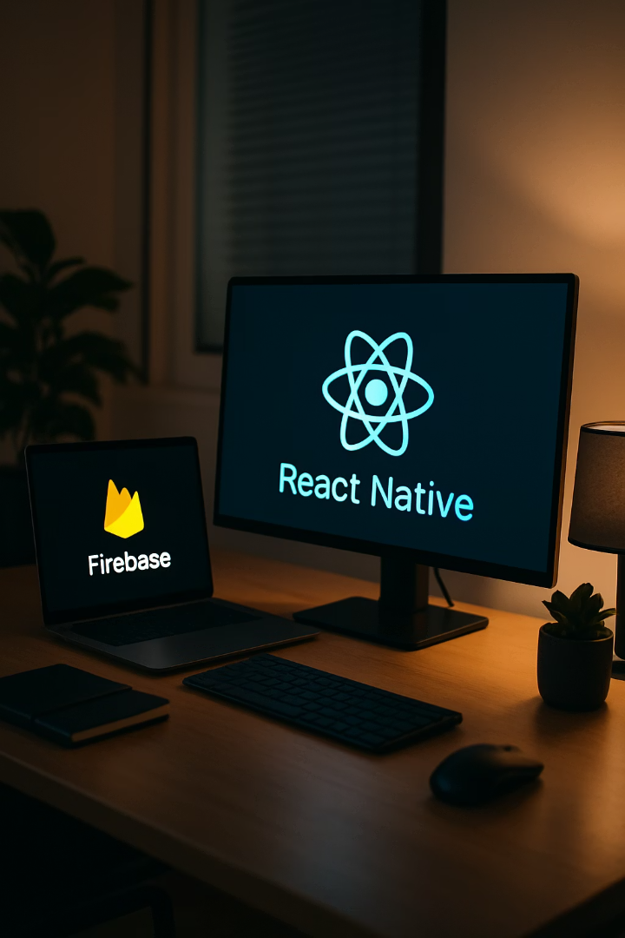

Technical Prerequisites
Development Environment
Firebase Account
Google Firebase account
Node.js (v12 or newer)
Firebase project created
Expo CLI installed globally
Firebase config keys ready
Expo Go app on test devices
Dependencies
expo-notifications package
expo-device package
firebase/app and /messaging

Slide 4
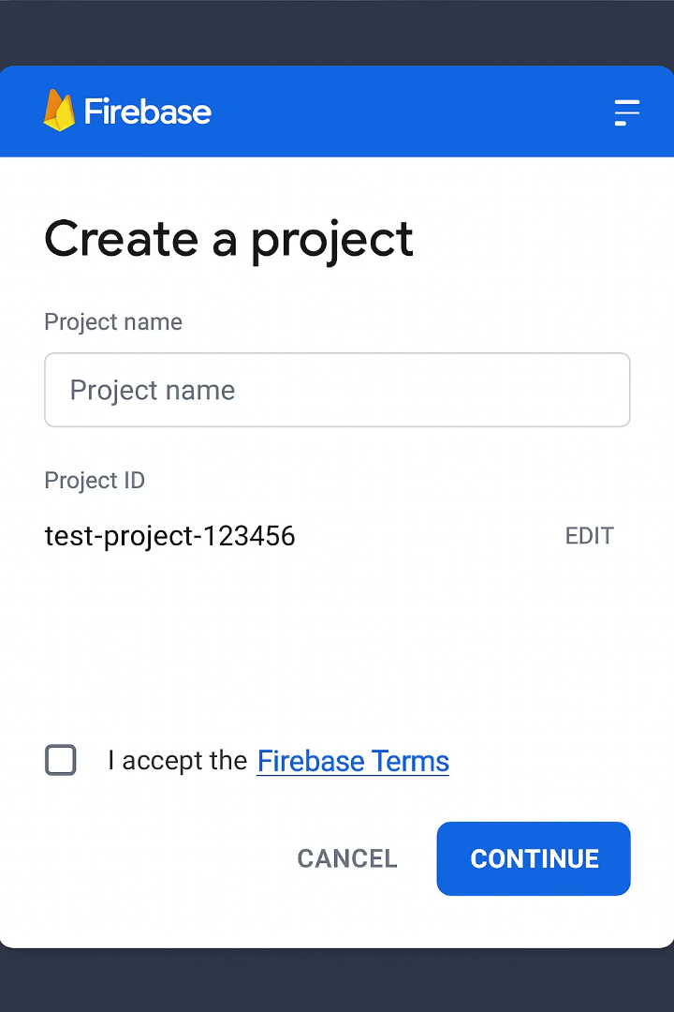
Setting Up Firebase Project
Create Firebase Project
Go to Firebase Console. Click "Add project" and follow the setup wizard. Give your project a name that matches your app.
Register Your App
Add iOS and Android platforms. Obtain the GoogleService-Info.plist and google-services.json configuration files.
Enable Cloud Messaging
Navigate to "Cloud Messaging" in the Firebase Console. Enable the API for your project.

Slide 5
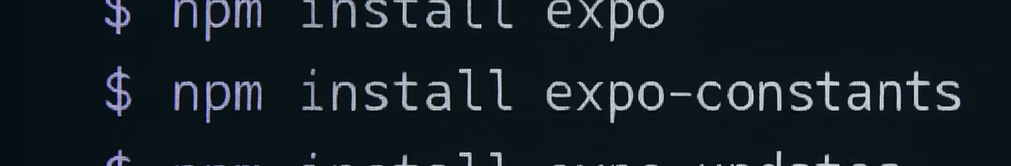
Installing Required Packages
// Install Expo notification packages expo install expo-notifications expo-device // Install Firebase npm install firebase // Optional: Install config plugin for native setup expo install @react-native-firebase/app
These packages form the foundation of our notification system. They handle token management, notification display, and Firebase integration.

Slide 6



Configuring app.json
Add Notification Settings
Configure basic notification appearance and behavior
Configure Android Settings
Set up Google services configuration path
Configure iOS Settings
Enable background modes and Push capability
The app.json file contains crucial configuration for Expo to generate proper native code with notification support.

Slide 7








Firebase Configuration in App
Create Config File
Initialize Firebase
Store Firebase credentials securely in your project
Set up Firebase in your app entry point
Validate Connection
Platform-Specific Setup
Ensure Firebase properly connects without errors
Handle iOS and Android differences

Slide 8
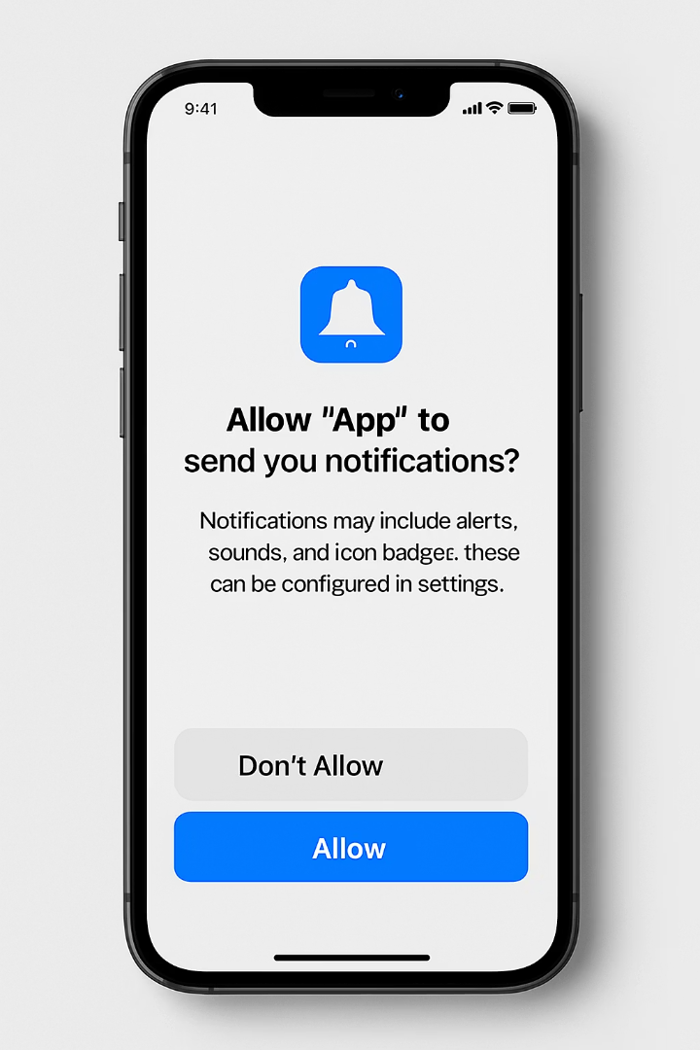
Requesting Notification Permissions
Permission Type
iOS Behavior
Android Behavior
Alerts
User prompt required
Granted by default
Sounds
Part of main prompt
Granted by default
Badges
Part of main prompt
Varies by device
Critical Alerts
Separate permission
Not applicable
Always request permissions at the appropriate time in the user journey. This improves acceptance rates.

Slide 9






Getting Push Tokens
Token Generation
Unique identifier for each device installation
Token Storage
Save tokens in your backend database
Token Refresh Handling
Update when devices change or reinstall
// Get Expo push token const token = await Notifications.getExpoPushTokenAsync({ projectId: Constants.expoConfig.extra.eas.projectId, }); // Store in your database await saveTokenToBackend(user.id, token.data);

Slide 10
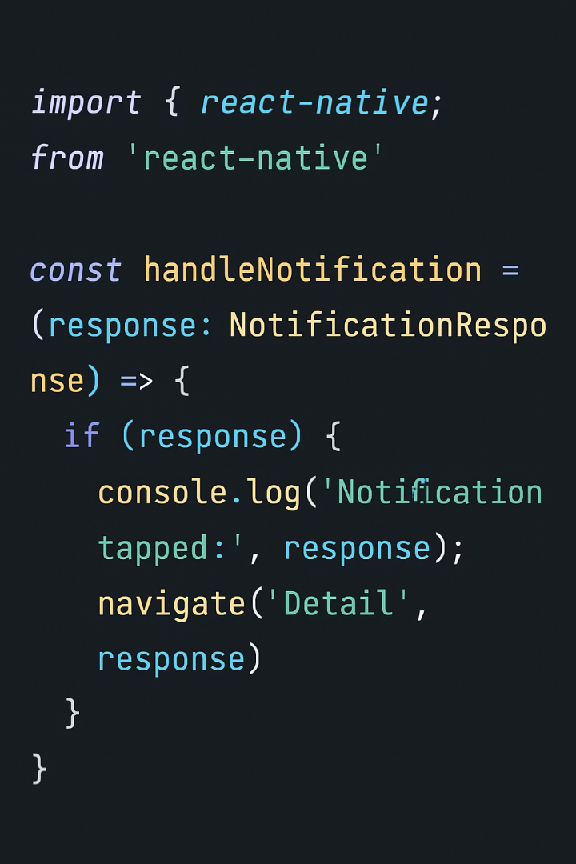



Creating a Notification Handler
Set Up Notification Listener
Create a handler for incoming notifications.
This must run at app initialization.
Define Display Behavior
Configure how notifications appear when app is open.
Control foreground notification visibility.
Handle Notification Taps
Respond when users interact with notifications.
Navigate to relevant screens based on payload.

Slide 11
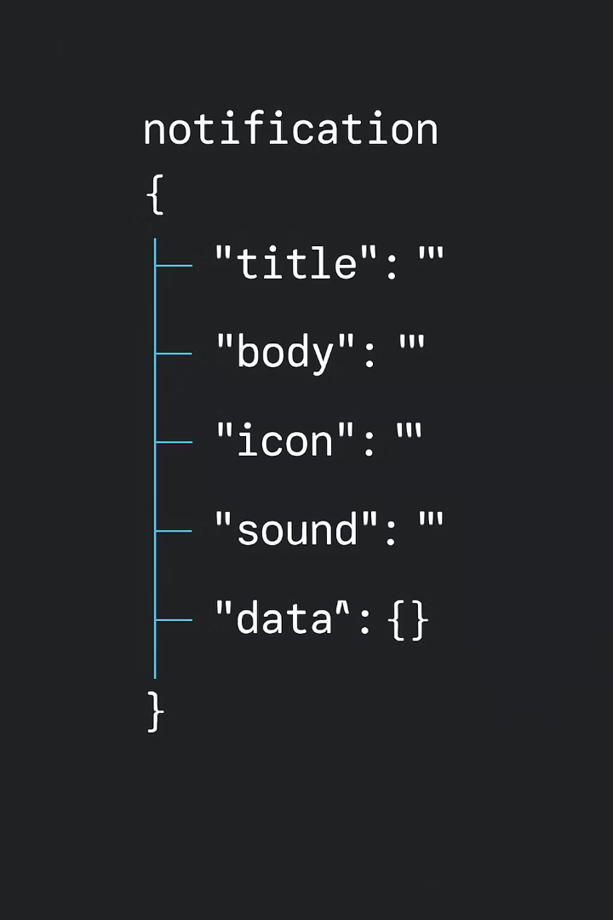



Notification Payload Structure
Title & Body
Data Payload
Rich Media
The main content users see. Keep titles under 40 characters and body text under 100 characters for best display.
Custom JSON data for your app. This can include screen routing information, IDs, or any app-specific data.
Add images with a "picture" field. Images should be publicly accessible URLs. Maximum size: 1MB.

Slide 12
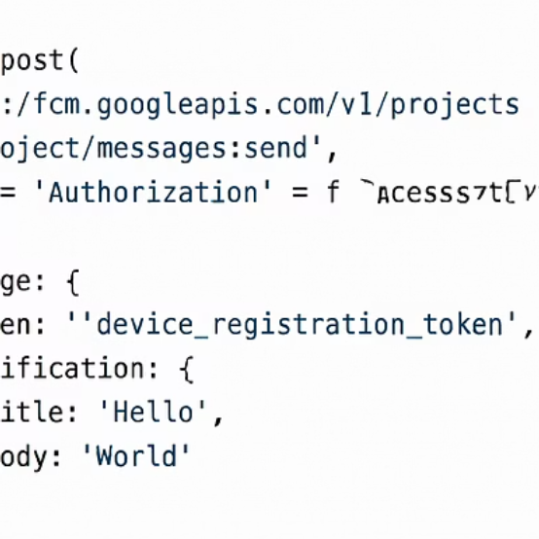
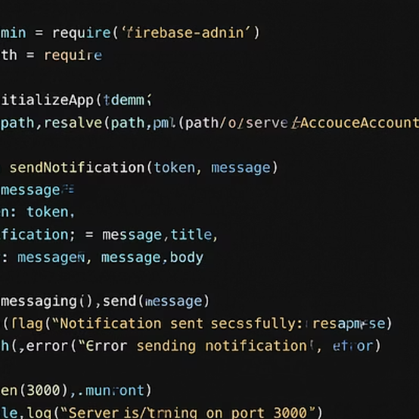
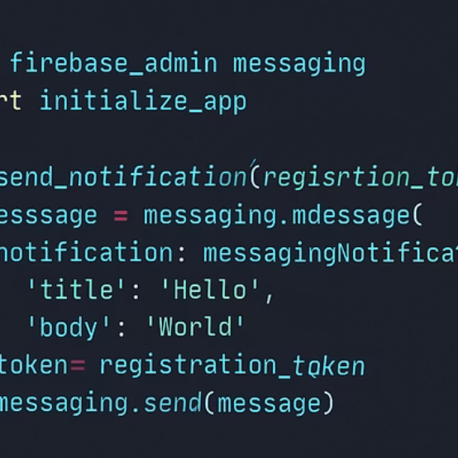
Sending Notifications From Backend
You can send notifications through Firebase Admin SDK or the FCM HTTP v1 API. Both require your server key from Firebase console. Never expose this key in client code.

Slide 13
Testing Push Notifications
Firebase Console Testing
Expo Push Tool
Custom Testing Tools
The simplest way to start testing. Navigate to Cloud Messaging → Send your first message.
Convenient for Expo-specific implementation testing.
Build your own testing UI for comprehensive validation.
Works with Expo tokens
Test different payloads
Target by token or topic
Simple web interface
Validate handling logic
Preview appearance
No Firebase config needed
Batch test notifications
Schedule delivery

Slide 14

Common Implementation Challenges
40%
iOS Certificate Issues
Most common error in push notification setups
35%
Token Handling
Incorrect token refresh implementation
27%
Payload Format
Malformed notification data structures
22%
Background Handling
Notifications not working when app is closed
Most issues stem from incorrect configuration rather than code problems. Always check your Firebase setup and certificates first.

Slide 15
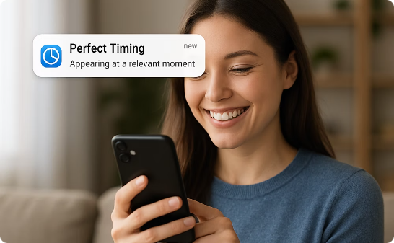
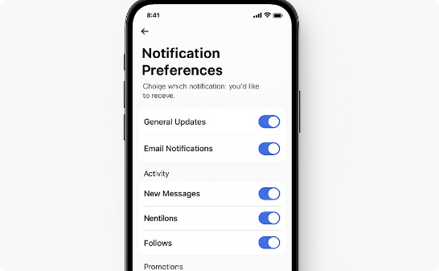
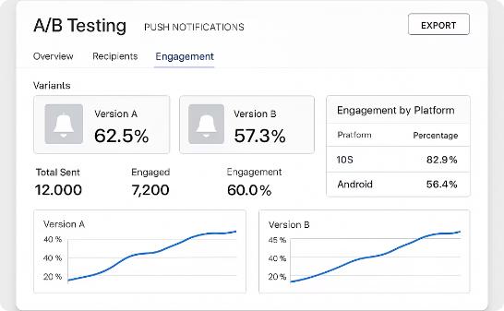
Best Practices & Next Steps
Send at the Right Time
Offer Detailed Preferences
Measure & Optimize
Respect user time zones. Avoid late night notifications unless critical. Use analytics to find optimal engagement times.
Let users choose notification categories. Implement frequency controls. Remember preferences across installations.
Track open rates and conversion actions. A/B test notification content. Analyze user segments for targeted messaging.

